Slide 1
The Design of an Autonomous Car car
FAVOUR DADA
JESUDARA OMIDOKUN
ADURALERE SULAIMAN

Slide 2
OUTLINE
Background
Project Objectives
Design Requirements
Design Constraints
System Description
Implementation Plan
Implementation of Tasks
Future Plans
Questions

Slide 3
Background
mmWave is an extremely valuable sensing technology for detection of objects and providing the range, velocity and angle of these objects.
It is a contactless-technology which operates in the spectrum between 30 GHz and 300GHz.
Due to the technology’s use of small wavelengths it can provide sub-mm range accuracy and is able to penetrate certain materials such as plastic, drywall, clothing, and is impervious to environmental conditions such as rain, fog, dust and snow.

Slide 4
Background
TI has two families of mmWave sensors, AWR mmwave sensor for automotive and IWR mmWave sensor for industrial, drones and medical applications.

Slide 5
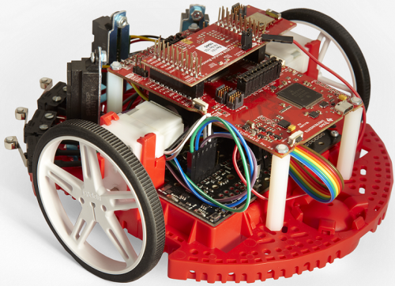
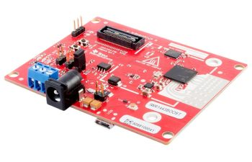
Background
TI-RSLK
IWR1443BOOST

Slide 6
Objective
The objective of the autonomous car is to provide geographical information such as the range, velocity,angle and 3D imaging of objects in an unknown area.

Slide 7
Design Requirements
The device will be able to produce data using a point cloud system
The radar configuration will help calculate the ground speed independent of wheel rotation
The device would be able to work in different weather conditions. such as rain, snow e.t.c
The autonomous car weight will be in the range 18g to 25g
The payload of the car

Slide 8
Design Constraints
The tires might not be able to move in certain areas.
Battery will have to be recharged after about 9 hours of use

Slide 9
System Diagram

Slide 10
Implementation Plan

Slide 11
Implementation Plan
Task 1. RLSK Design
Subtask 1. Assembly of TI RSLK Kit
Subtask 2. Modification of the Code for Obstacle avoidance
Subtask 3. Modification of the Code for
Task 2. Implementation of Microcomputer
Subtask 1. Installing Ubuntu on Pi 3.
Subtask 2. Connecting the MMwave interface with the microcomputer
Subtask 3. Change the Pi 3 to ODROID XU4Q
Subtask 4. Alteration of pi code to fit the ODROID.
3. Task 3. Implementation and development of the MMwave (IWR 1443 Boost)
Subtask 1. Connecting the mmwave to RSLK board
Subtask 2. Writing the code for sensing system.
4. Task 4. Functions
Subtask 1. Acquisition of the point cloud data from the radar with the microcomputer .
Subtask 2. Stitching the acquired data
Subtask 3. Calculating the velocity independent of the wheel rotation
Subtask 4. Detecting and calculating the distance of an object behind the glass wall.

Slide 12
5. Task 5.
6. Task 6. System reassembly, testing and refinement

Slide 13
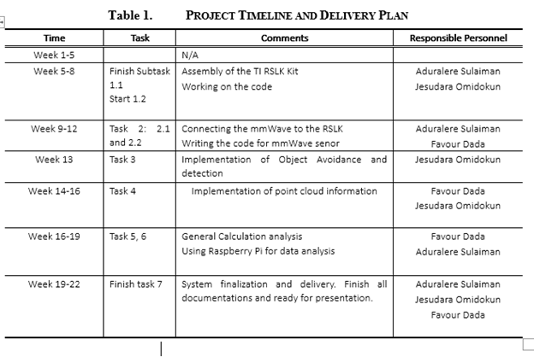

Slide 14
Implementation

Slide 15
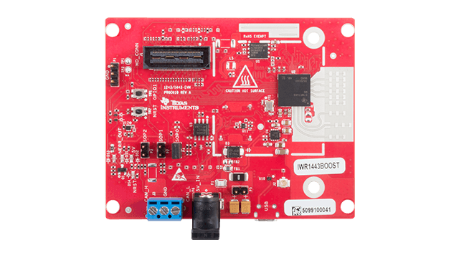
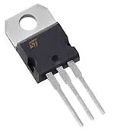
Materials
-IWR1443BOOST(mmwave)
-DC Converter(12V to 5V)
-mmwave ROS Driver
-TI mmwave SDK(Software)
-TI RSLK
- ODROID-XU4Q(microcomputer)
-

Slide 16
Task 1.1

